Slide 1
VRP Foundation

Slide 2
As more and more end stations in the form of host devices, networkable printers other similar products are introduced into the local area network, an increase in the density of devices results in a limitation in terms of port interfaces, along with problems of collisions within any shared network topology. Switching has evolved as the means for supporting this growth. VRP is used within Huawei products as a means to configure and operate such managed devices for which familiarity and hands-on skills must be developed.

Slide 3
Upon completion of this section, you will be able to:
  Explain the role switches play in the Ethernet networks.
  Describe the difference between collision and broadcast domains.
  Explain the general operation of VRP in Huawei products.

Slide 4


Application of Switching Devices
Switches generate multiple collision domains.
Switch A
Tx
Switch B
Rx
Host A
Host B
Host C
Host D
Notes:
The Ethernet network until now has been understood to be a collection of devices communicating over shared media such as 10Base2, through which hosts are able to communicate with neighboring hosts or end systems. It has been determined that the Ethernet network is a contentious network, meaning that hosts must compete for media access which becomes increasingly limited as more and more devices are connected over this shared media; which causes additional limitations in scalability and the increasing potential for collisions.
As a result, the need for collision detection in the form of CSMA/CD is ever present in such shared Ethernet networks. Following the adoption of switched media such as that of 100BaseT, data transmission and reception became isolated within channels (wire pairs), enabling the potential for collisions to occur to be eliminated. This medium as a form of non-shared Ethernet provides only a means for point-to-point communication, however used together with other devices such as hubs, a shared Ethernet network is once again possible, along with the potential for collisions.
The switch was introduced as part of the evolution of the bridge, and is capable of breaking down the shared collision domain into multiple collision domains. The collision domains operate as a collection of point-to-point links for which the threat of collisions is removed and link-layer traffic is isolated, to allow higher transmission rates that optimize traffic flow within the Ethernet network.

Slide 5


Application of Routing Devices
Gateway devices such as routers generate broadcast domains.
Switch A
Switch B
RTA
Host A
Host B
Host C
Host D
Notes:
A broadcast domain is capable of being comprised of a single, or multiple collision domains, and any broadcast transmission is contained within the boundary of a broadcast domain. The edge of a broadcast domain’s boundary is typically defined by a gateway that acts as the medium, via which other networks are reachable, and will restrict the forwarding of any broadcast traffic beyond the interface on which the broadcast is received.
Routers are synonymous with the term gateway for which the two are often used interchangeably. A single IP network can generally be understood to make up a broadcast domain, which refers to the scope of a link-layer segment. Routers are generally responsible for routing Internet datagrams (IP packets) to a given destination based on the knowledge of a forwarding address for the destination network, found within an internally managed forwarding table.

Slide 6








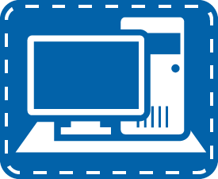







Introduction To VRP
VRP is the platform on which many Huawei products operate.
Switching
Routing
Security
Unified Management
UTM
WLAN/WWAN
Notes:
The Versatile Routing Platform (VRP) represents the foundation of many of Huawei products including routers and switches. Its design has been through many evolutions to enable continuous improvement of data management and forwarding. The architectural design has resulted in ever enhanced modularity that allows for greater overall performance. The configuration, management and monitoring of devices using VRP is based on a standardized and hierarchical command line system for which a familiarity should be developed to support navigation and operation of Huawei products managed using VRP software.

Slide 7
VRP Timeline
VRP versions 5 and 8 are currently used in Huawei products.
VRP 8
VRP 5
VRP 3
VRP 2
VRP 1
1998-2001
1999-2001
2000-2004
2000-now
2009-now
Notes:
A familiarity with the versions of VRP network operating system (NOS) aids in ensuring that the version currently being used is up to date and supports certain features that may be required in an enterprise network. The general trend for most Huawei devices is to operate using VRP version 5.x currently, where x may vary depending on the product and VRP release. VRP version 8 is a recent revision of VRP built with a highly refined architecture for the next generation of technologies and constructed around the need for greater efficiency, but is not present in all Huawei products.

Slide 8
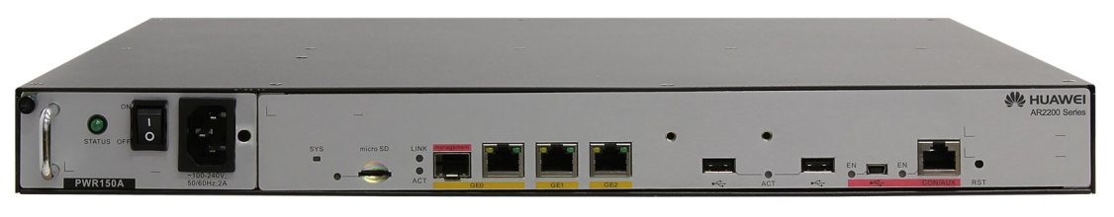
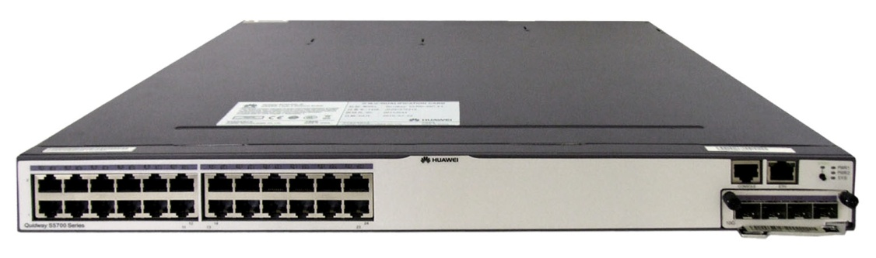
Establishing Connectivity
AR2200
Mini USB
Console
S5700
Console
Notes:
AR series enterprise routers (AR) include the AR150, AR200, AR1200, AR2200, and AR3200. They are the next-generation of Huawei products, and provide routing, switching, wireless, voice, and security functionality. The AR series are positioned between the enterprise network and a public network, functioning as an ingress and egress gateway for data transmitted between the two networks. Deployment of various network services over the AR series routers reduces operation & maintenance (O&M) costs as well as costs associated with establishing an enterprise network. AR series routers of different specifications can be used as gateways based on the user capacity of an enterprise.
The Sx7 Series Ethernet Switch provides data transport functionality, and has been developed by Huawei to meet the requirements for reliable access and high-quality transmission of multiple services on the enterprise network. This series of switch is positioned for access or aggregation layer operation in the enterprise network, and provides a large switching capacity, high port density, and cost-effective packet forwarding capabilities.
Management of the ARG3 series routers and Sx7 series of switch can be achieved through establishing a connection to the console interface, and in the case of the AR2200, a connection is also possible to be established via a Mini USB interface.

Slide 9
Device Access via Console
A physical connection is established between the serial (COM) port and the console interface of the router/switch.
Host A
Console Cable
RTA
COM Port
Console
Notes:
A console cable is used to debug or maintain a locally established device such as a router or switch, and will interface with the console port of such devices. The console interface of the S5700 series switch and the AR2200 router is an RJ-45 type connection, while the interface to which a host connection is made, represents an RS-232 form of serial connector. Often such serial connectors are no longer present on newer devices that can be used for establishing connectivity, such as laptop computers, and therefore an RS-232 to USB conversion is performed. For most desktop devices however, an RS-232 based console connection can be established to a COM port on the host device.

Slide 10
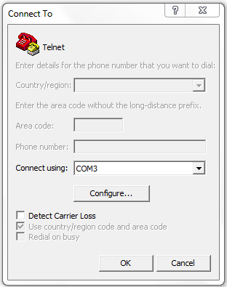
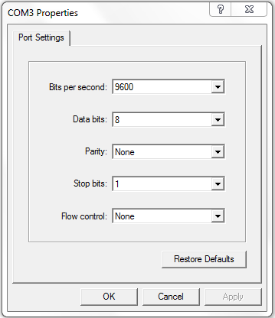
Console Access Setup Procedures
Please configure the login password (maximum length 16)
Enter password:huawei
Confirm password:huawei
<Huawei>
Notes:
Console establishment is set up through one of a number of available terminal emulation programs. Windows users often apply the HyperTerminal application as shown in the example to interface with the VRP operating system. Following specification of the COM port that is to be used to establish the connection, port settings must be defined.
The example defines the port settings that should be applied, for which the restore default button will automatically reassign should any change have been made to these settings. Once the OK button is pressed, a session will be established with the VRP of the device. If the device is operating using factory default settings, the user will be prompted for a password, which will be assigned as the default login password for future connection attempts.

Slide 11
Router Access via Mini USB
Connection is made between the USB port of the host and the mini USB interface of the router.
Host
Router
USB Cable
USB
Mini USB
Notes:
The Huawei AR2200 router, additionally supports the means for terminal connectivity via a USB connection. A type B mini USB interface exists on the front panel of the AR2200 series router through which hosts are able to establish a USB based connection as a serial alternative to that of RS-232.

Slide 12
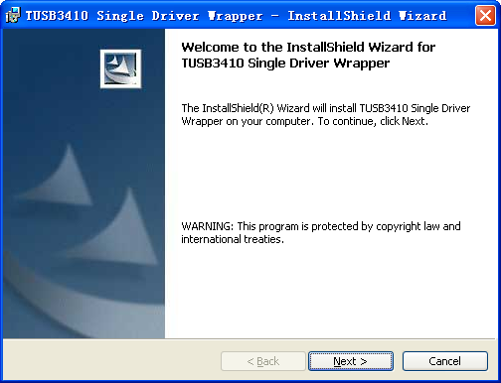
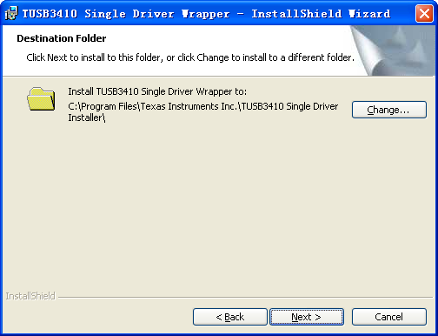
Mini USB Driver Installation
Installation of drivers for the USB connection may be required.
Notes:
A slight variation in the setup process requires that the mini USB firstly establish drivers to allow USB functionality. The mini USB driver can be obtained by visiting http://support.huawei.com/enterprise, and under the path Support > Software > Enterprise Networking > Router > Access Router > AR > AR2200, choose the relevant VRP version & patch path option, and download the file labeled AR&SRG_MiniUSB_driver.zip. It should be noted that the mini USB driver supports only Windows XP, Windows Vista, and Windows 7 operating systems.
When upgrading the device software or installing a patch, the MD5 hash value can be checked to confirm software validity. In order to prevent the software from being modified or replaced, you are advised to perform this operation.
Installing requires the user to firstly double-click the driver installation file on the PC and click Next. Secondly select I accept the terms in the license agreement and click Next. Click the Change button to change the driver directory if required, and click Next. Click Install and decompress the driver. When the system finishes decompressing the driver, click Finish.
Users should then find the DISK1 folder in the specified driver directory, and double-click the file setup.exe. Following the opening of a second installation window click Next. Users should again select I accept the terms in the license agreement and click Next to install the driver. Once complete, click Finish to finish installing the driver. Right-click My Computer, and choose Manage > Device Manager > Ports(COM&LPT). The system should display the TUSB3410 Device indicating the driver that has been installed.

Slide 13
Mini USB Access Setup Procedures
Please configure the login password (maximum length 16)
Enter password:huawei
Confirm password:huawei
<Huawei>
Notes:
As with the RS-232 console connection, the Mini USB serial connection requires establishment to terminal emulation software to enable interaction with the VRP command line.
Use the terminal emulation software to log in to the device through the mini USB port, (for which the Windows HyperTerminal is used as an example). On the host PC, start the HyperTerminal application, for which the location may vary for each version of Windows, and create a connection by providing a suitable terminal connection name and click OK. Select the relevant connection (COM) port and then set the communication parameters for the serial port of the PC. These parameters should match the default values that are set when pressing the Restore Defaults button.
After pressing Enter, the console information is displayed requesting a login password. Enter a relevant password and confirmation password, and the system will save the password.

Slide 14
  If an Ethernet broadcast occurs such as in the case of ARP, to which the destination is local, what will the response of the gateway be?
  Which versions of VRP are currently supported by Huawei products?
Notes:
Any broadcast that is generated by an end system within a local network will be forwarded to all destinations. Once a frame is broadcast to a router or device acting as a gateway for the network, the frame will be analyzed and should it be determined that the destination is for a locally defined host other than the gateway, the frame will be dropped. This as such defines the boundary of any broadcast domain.
VRP version 5 is supported by a large number of current Huawei products, while high end products may often be supported by VRP version 8.

